Slide 1
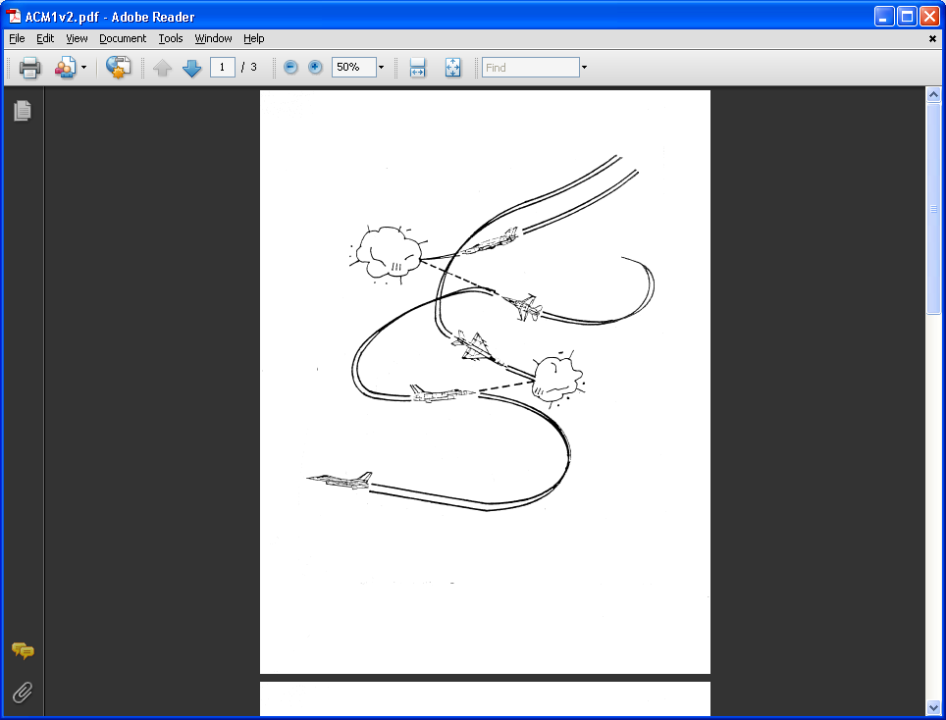
AE 317 Flight Mechanics and Performance
Specific Excess Power
LECTURE 21
Dr. Jeff Ashworth
Aerospace Engineering Department

Slide 2
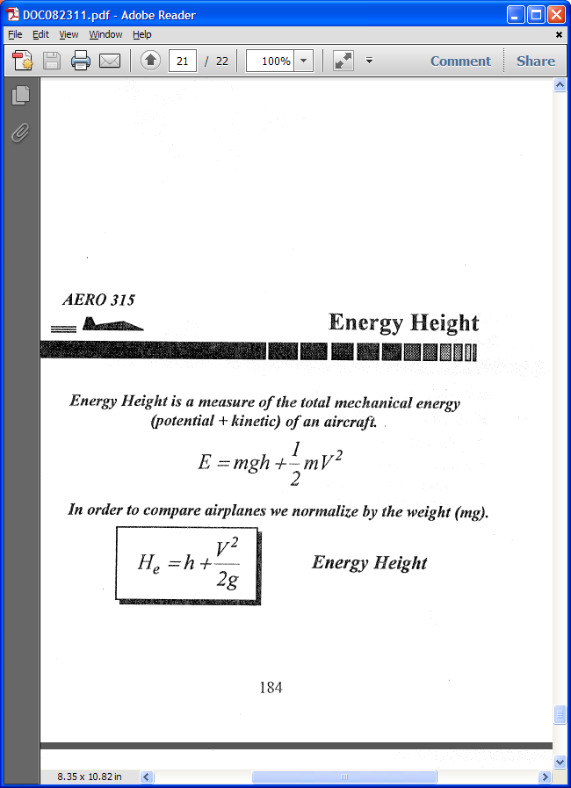
(Brandt)

Slide 3
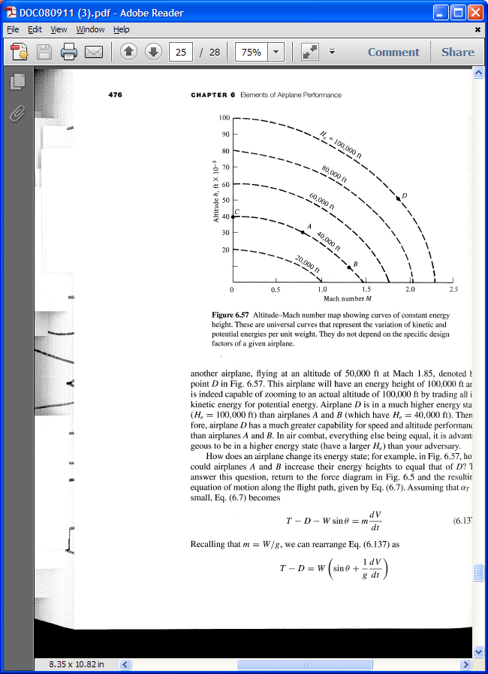
(Anderson)

Slide 4
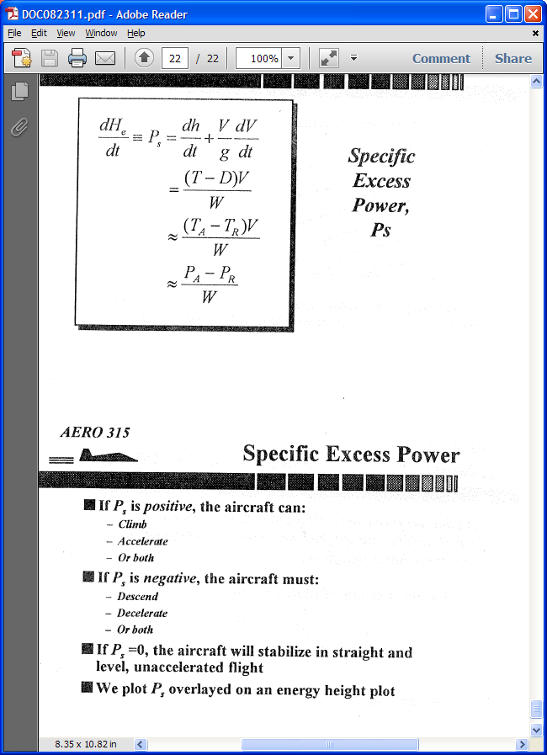
(Brandt)

Slide 5
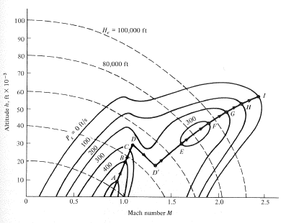
(Anderson)

Slide 6
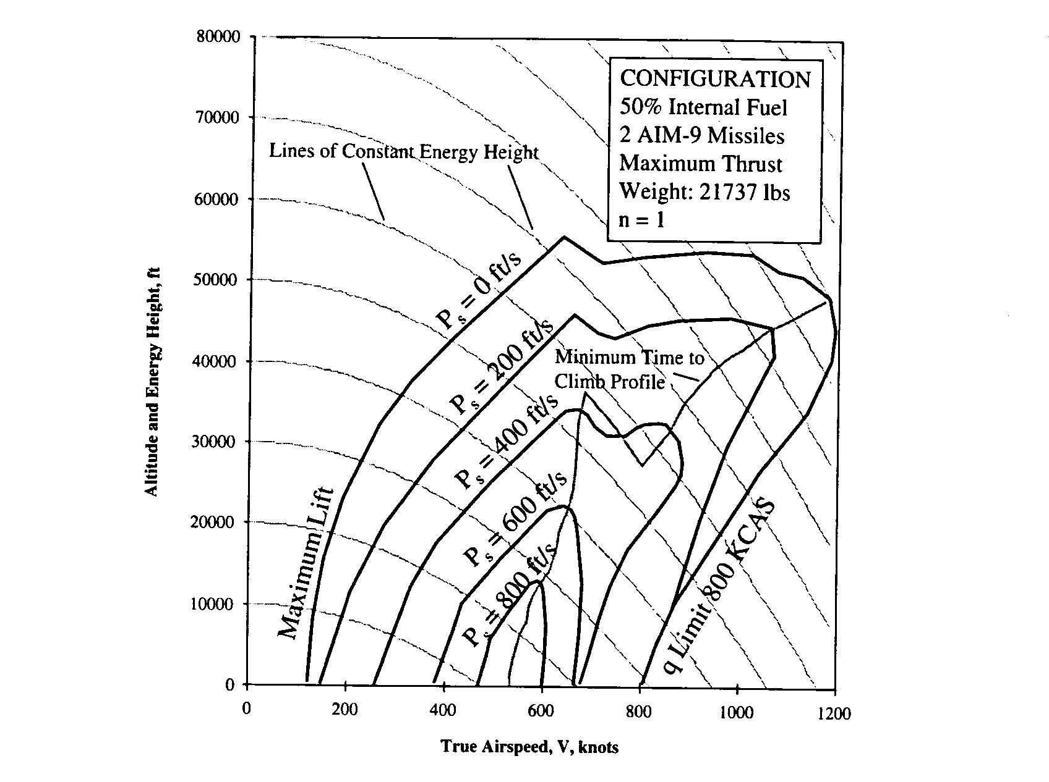
(Brandt)

Slide 7
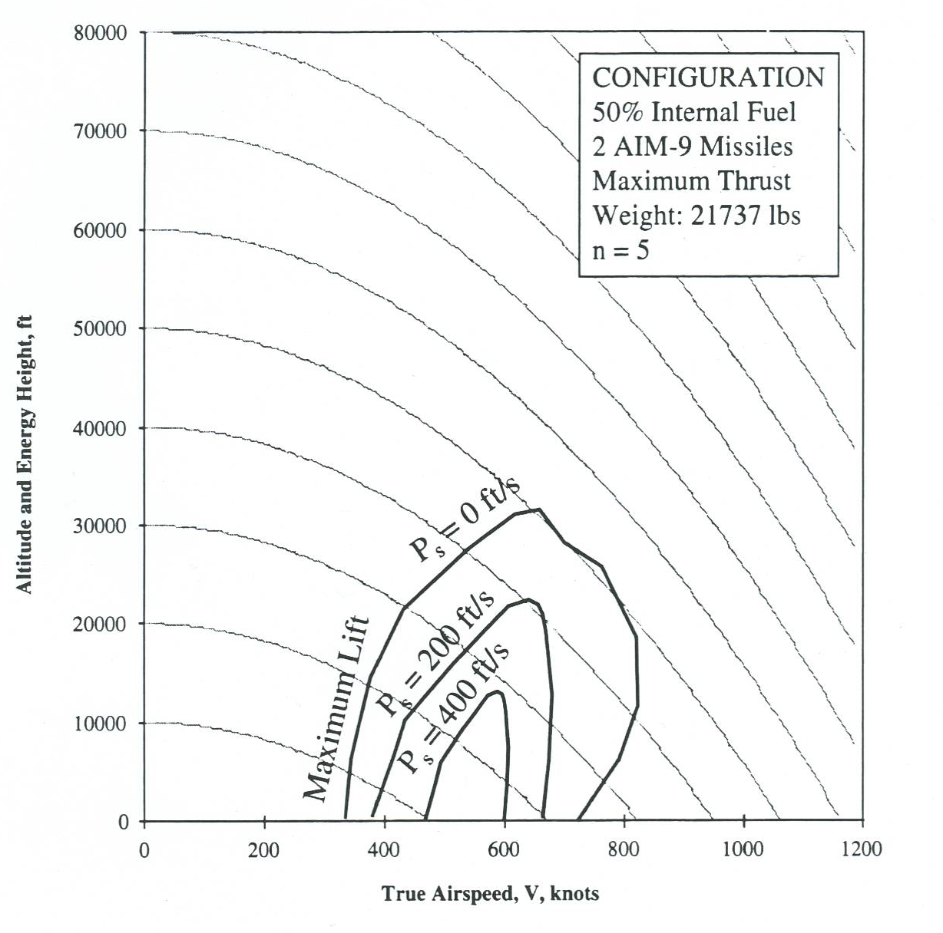
(Brandt)

Slide 8
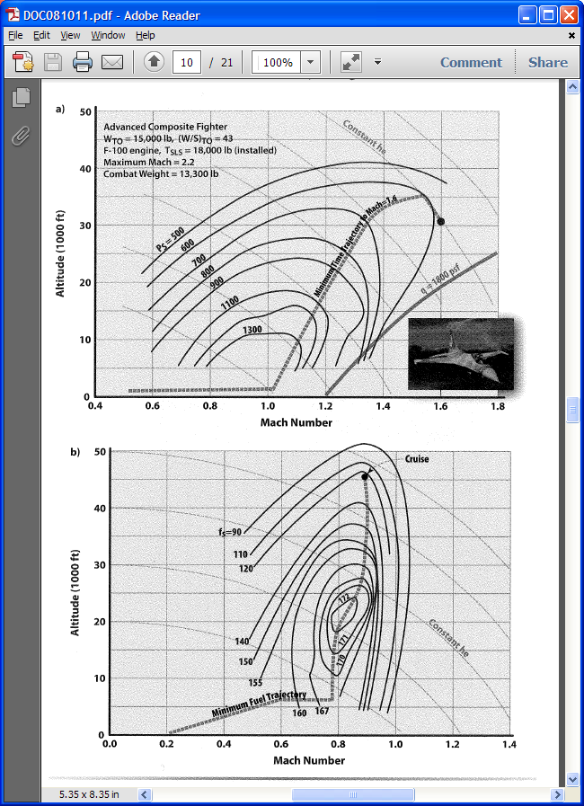
(Nicolai/Carichner)

Slide 9
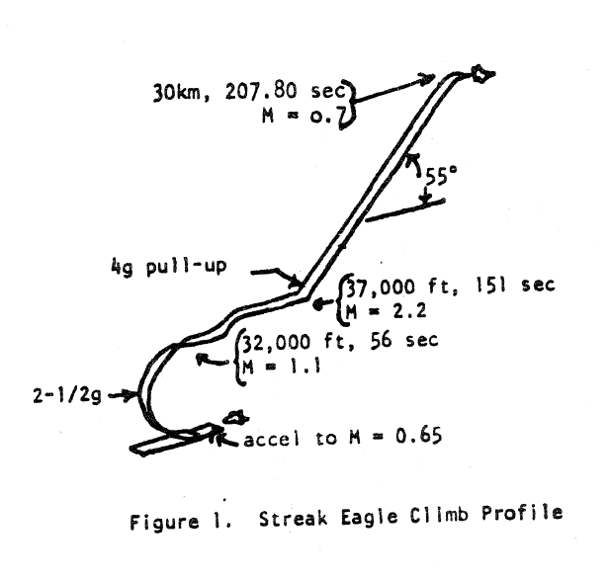
DFAN-USAFA

Slide 10
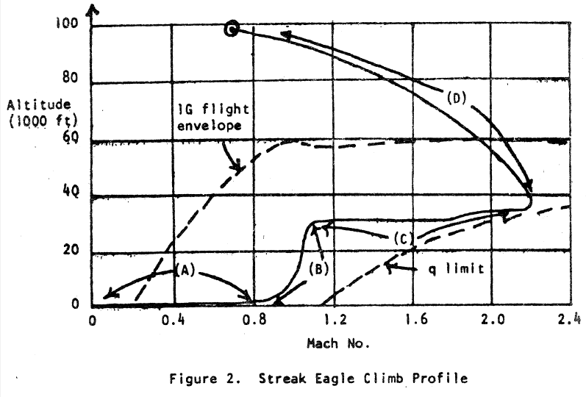
DFAN-USAFA

